Slide 1
Multiple choice quiz app
CSc 221 – Spring 2020
Instructor: Ayman Zeidan
By: Bingjing Dong

Slide 2
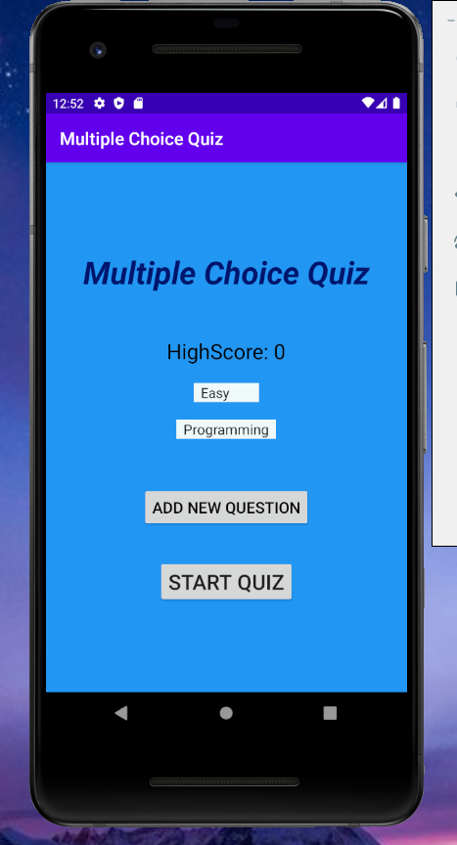
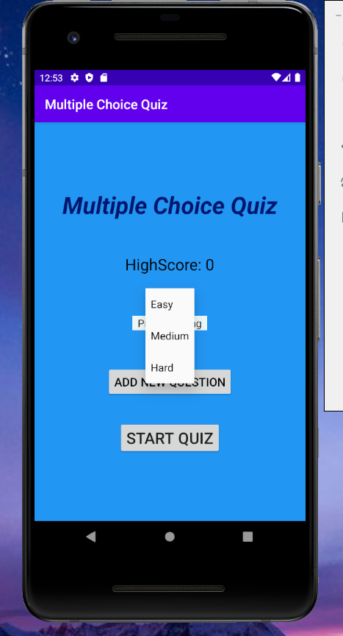
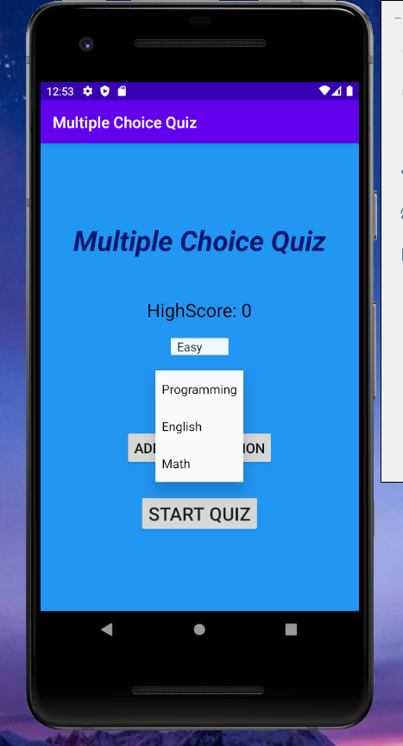
Starting screen
1) A high score, high score will show in the main menu, it will save the high score of user got.
2) Difficulty levels, there are three difficulty level, easy – medium – hard, user can choose one of them to take.
3) Categories, there are three categories, programming – English – Math, user can choose one of them to take
4) A Add new question button in the main menu, user can add their own questions to database with exist categories and difficulty level.

Slide 3
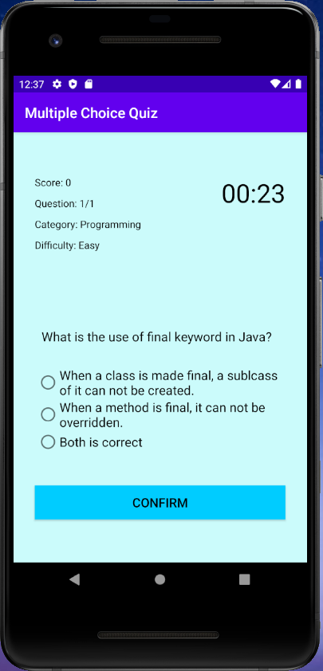
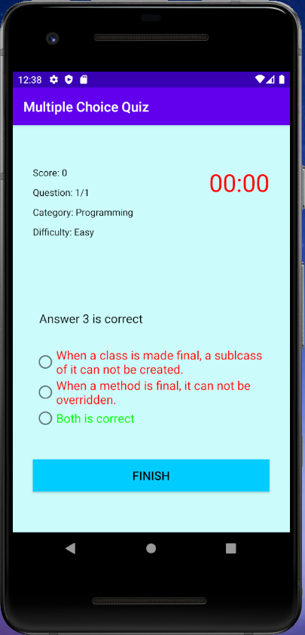
When time’s up and no answer been choosed
1) There are 10 questions total with different categories and difficulty levels initially.
2) On the left top of screen, shows Score, question number, category and difficulty level. Score starts from 0.
3) On the right top of screen, showa a countdown timer. It starts from 30 second, when time run to 10 second or less, the text color change from black to red.
4) When time is up, if user choose an answer, then it will check if answer is correct or not. Otherwise, it will display the correct answer and mark wrong, then will not increase the score.

Slide 4
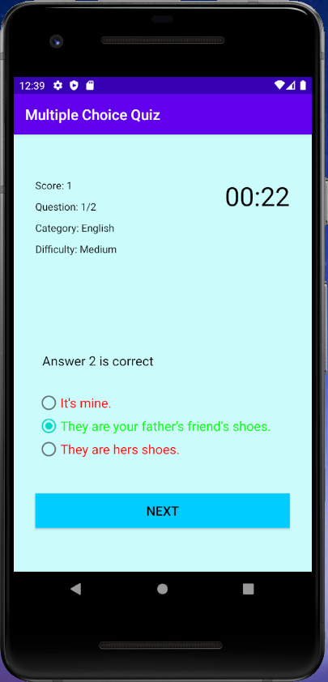
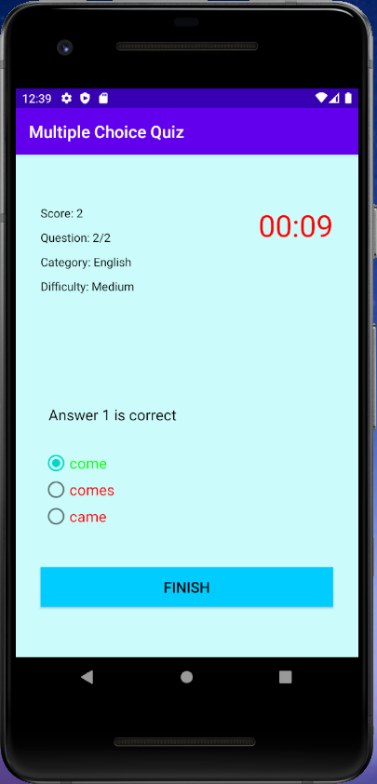
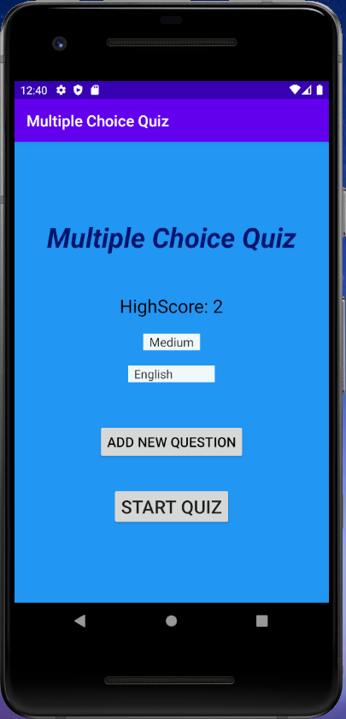
How the quiz work
When user choose an answer and click confirm, if the answer is correct, it will add 1 point to score, otherwise no point.
The correct answer shows in green color, wrong answer shows in red color.
If there still have question left, ‘Confirm’ button change to ‘Next’ button. When user reach to last question, ‘Confirm’ button will change to ‘Finish’ button.
HighScore will update if user got score higher than before.

Slide 5
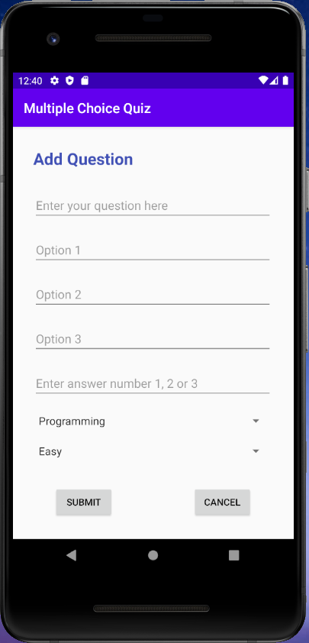
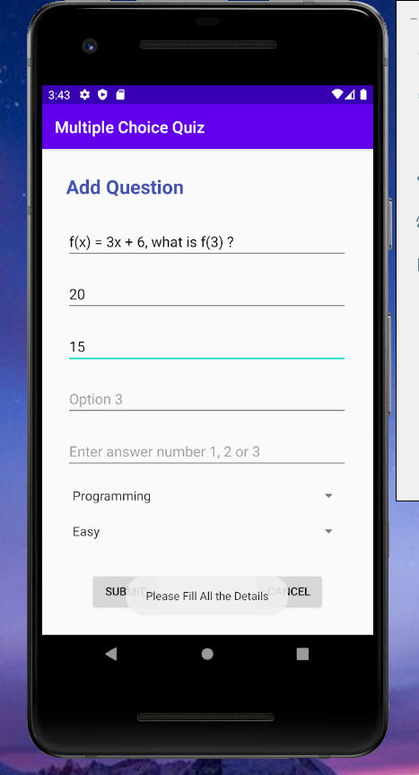
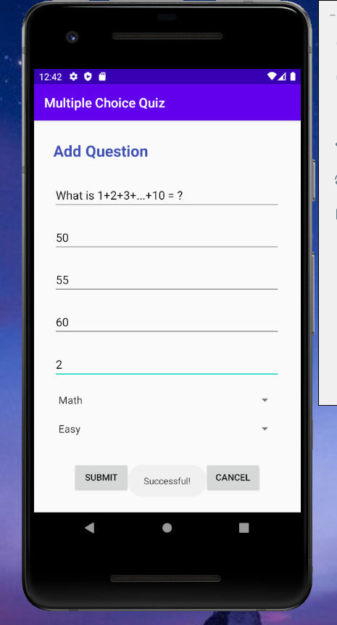
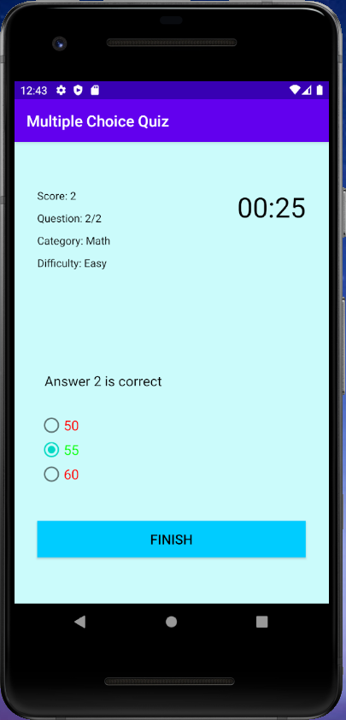
Add question by user
When user click ‘Add New Question’ in the main menu, the screen will change to Add Question.
User can follow the hint to create their question. If user didn’t fill all part and try to click ‘Submit’, it will show a message ‘ Please Fill All the Details’ .
When user finish all part and click ‘Submit’, it will show message ‘Successful’ and return to main menu.
When user click ‘Cancel’, the data will no save and return to main menu.
If user successful add question, it will show in the quiz with the category and difficulty level he/she choose.

Slide 6
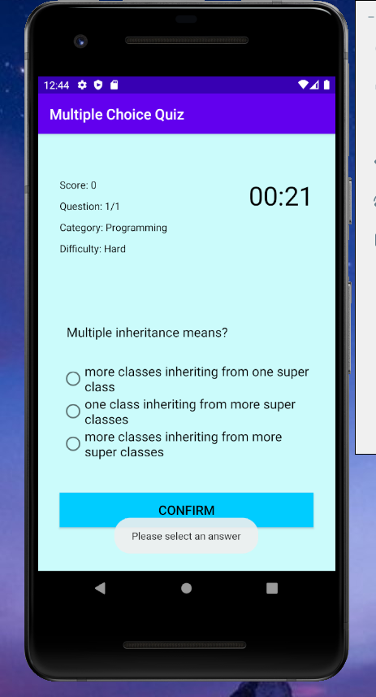
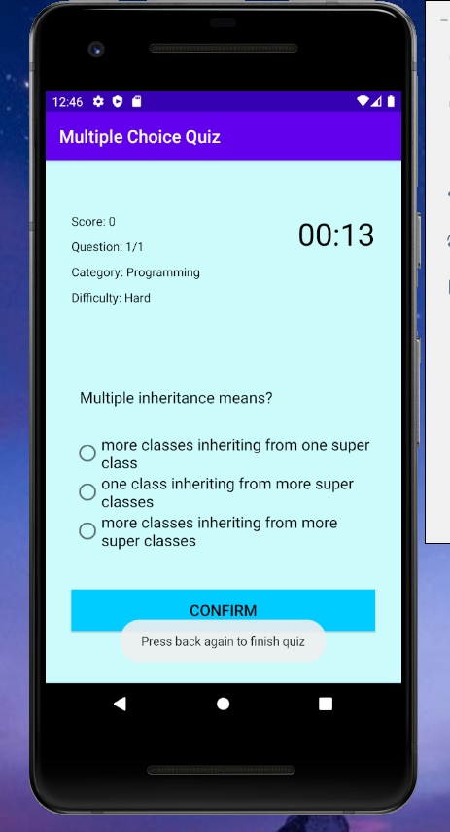
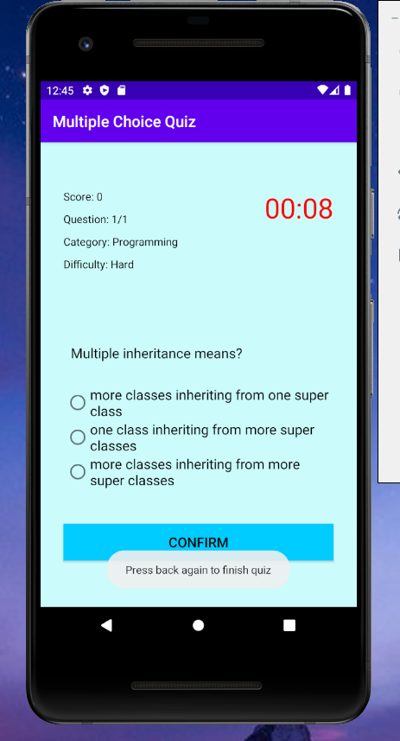
When user click confirm and back by accident
When user try to click Confirm button without answer, it will show a message that ask user to make choose.
If user click back button by accident, it will ask user to click again to make sure that want to quit the quiz. Only if user click back twice continuously within 2 second, the quiz will end and return to main menu. Otherwise it will stay on quiz.

Slide 7
Data save/retrieval and structure using
Challenges
I use SQLite database to save/retrieval data. Our data is always stored with the application from install time.
SQLiteDatabase has methods to create, delete, execute SQL commands, and perform other common database management tasks.
I use List and ArrayList to store question with its option answer, category and difficulty level in the index.
ArrayList allows us to randomly access the list. There are many method in ArrayList can help me to add, delete or check if it’s empty.
1) to understand and use the different data type for my feature. For example, I have one feature for time countdown. I choose to use Android CountDownTimer. Because I want to do a countdown of 30 seconds and know how much time is left every second.
2) to understand and know which function to overwriter
3) go through the example code in the Android Tutorial and rewrite it for me to use

Slide 8
What I learned
What I want to add
1) Creating Android App using Android Studio
2) Editing and styling xml file both by code and design
3) To understand different method do in Android Studio, like onCreate, setOnClickListener, etc
1) allow user to add and delete category from main menu
2) allow user to delete questions they don’t want anymore from main menu

Slide 9
Thank you

